Slide 1

LINUX
Operating System
Course Title: Operating System Course Code: ICT-2201
Presented By Imran Hossen (ID: IT-24063) Department of ICT, MBSTU
Supervised By Dr. Nazrul Islam Associate Professor, Dept. of ICT, MBSTU

Slide 2
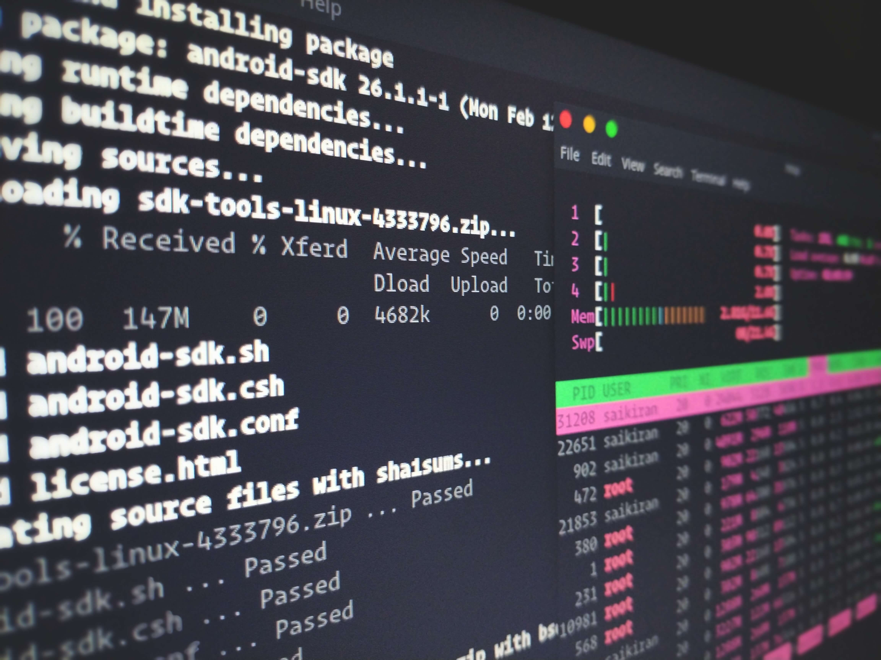
What is Linux?
Open-Source OS
Freely available, modifiable, and distributable by anyone.
Unix-Based Architecture
Built on solid Unix design principles ensuring stability.
Resource Management
Efficiently manages both hardware and software resources.
Free to Use & Modify
No licensing costs — customize to your exact needs.

Slide 3
Key Features of Linux
Multi-User
Multitasking
High Security
Multiple users can run sessions simultaneously without conflict.
Runs multiple processes in parallel efficiently.
Robust permissions and access control system.
Customizable
Command Line
Open Source
Modify kernel, UI, and tooling to suit any need.
Powerful shell interface for complete system control.
Community-driven development, no vendor lock-in.

Slide 4
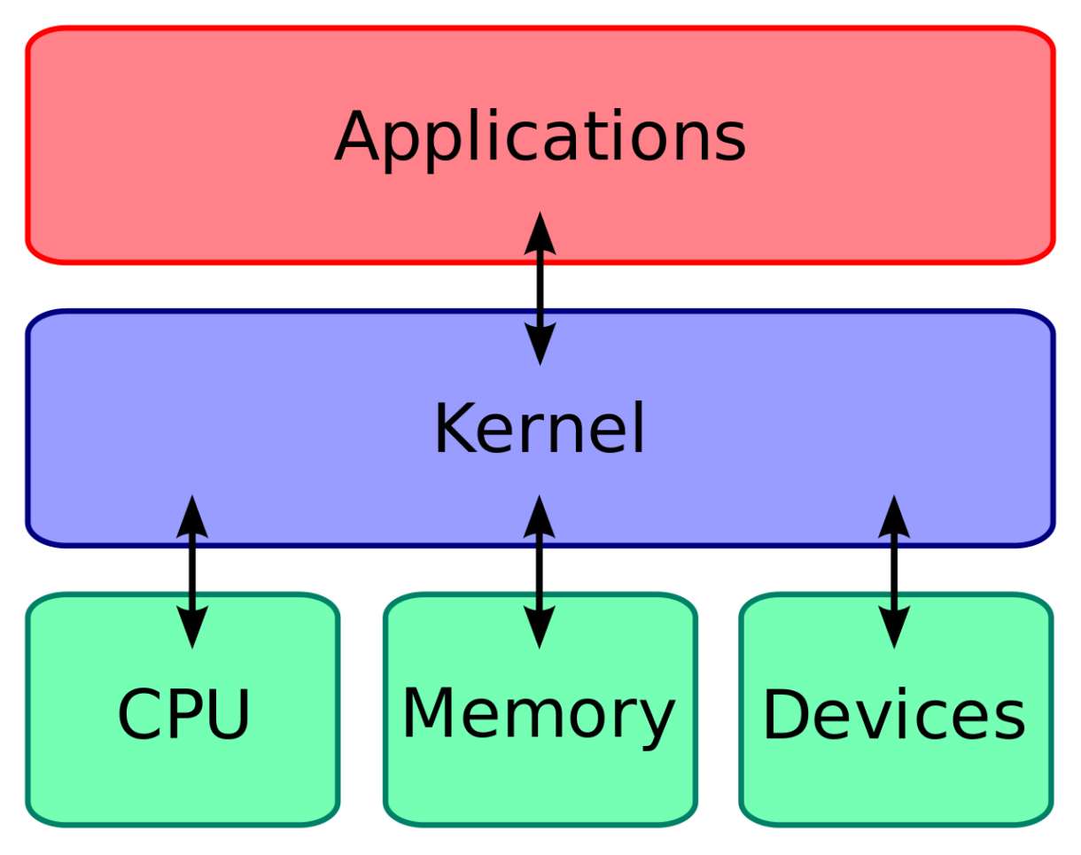
Linux Architecture & Components
User Space
End users & applications
Applications
Software programs & utilities
Shell
Command interpreter (Bash, Zsh)
Kernel
Core OS — memory, process, I/O mgmt
Hardware
CPU, RAM, Storage, Network
The Linux Stack

Slide 5
Popular Linux Distributions
Ubuntu
Debian
Fedora
Best for beginners & desktop users
Rock-solid stability & server use
Cutting-edge features & developers
Kali Linux
Red Hat
Cybersecurity & penetration testing
Enterprise-grade commercial Linux

Slide 6
How Linux Works
1
2
3
4
5
User Input
Shell
Kernel
Hardware
Output
User types a command in the terminal
Shell interprets the command text
Kernel processes and routes the request
Hardware executes the physical operation
Result is displayed back to the user

Slide 7
Advantages vs Disadvantages
✔ Advantages
✘ Disadvantages
▸ Free and open-source
▸ Steeper learning curve
▸ Highly secure and stable
▸ Limited software compatibility
▸ Fully customizable
▸ Requires command-line knowledge
▸ Excellent performance
▸ Less gaming support
▸ Large community support
▸ Hardware driver gaps
▸ Runs on older hardware

Slide 8


Linux in the Real World
Web Servers
96% of the world's top servers run Linux (Apache, Nginx).
Android OS
Android kernel is based directly on Linux.
Supercomputers
100% of the world's top 500 supercomputers use Linux.
Cloud Infrastructure
AWS, Google Cloud, Azure all run Linux at their core.

Slide 9
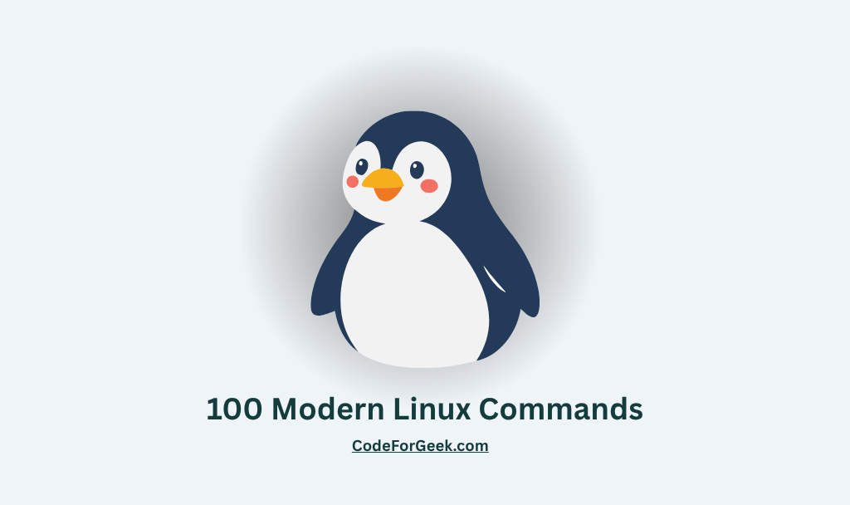
Essential Linux Commands
● ● ● terminal
$ ls
# list files and directories
$ cd /home
# change directory
$ mkdir projects
# create a new folder
$ rm file.txt
# delete a file
$ pwd
# print working directory
$ sudo apt update
# update package list

Slide 10
Summary
Linux is a free, open-source operating system with a global developer community.
It is the foundation of web servers, cloud platforms, Android, and supercomputers.
Its layered architecture (hardware → kernel → shell → applications) ensures stability.
Dozens of distributions serve every use case — from desktop to enterprise security.

Slide 11
Thank You
Questions & Discussion Welcome
Imran Hasan | IT24063 | Dept. of ICT, MBSTU

